Slide 1
“The AI Revolution in Healthcare"
Transforming Diagnosis, Treatment, and Patient Outcomes

Slide 2
Our Journey Today
• What is AI in Healthcare?
• Key Application Areas :More Than Just Robots,A Second Pair of Eyes: Diagnostics
• Interactive Scenario: The Diagnostic Dilemma What Do You Do?
• Benefits & The Human Touch
• Ethical Considerations
The Future is a Partnership
Q&A
Next

Slide 3
More Than Just Robots
AI involves machines performing tasks that typically require human intelligence.
In healthcare, this means:
• Machine Learning: Finding patterns in vast datasets (e.g., medical records, genomic sequences).
• Computer Vision: Analyzing medical images (X-rays, MRIs, retina scans).
• Natural Language Processing (NLP): Understanding and processing clinical notes and research papers.

Slide 4
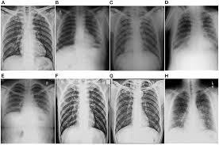
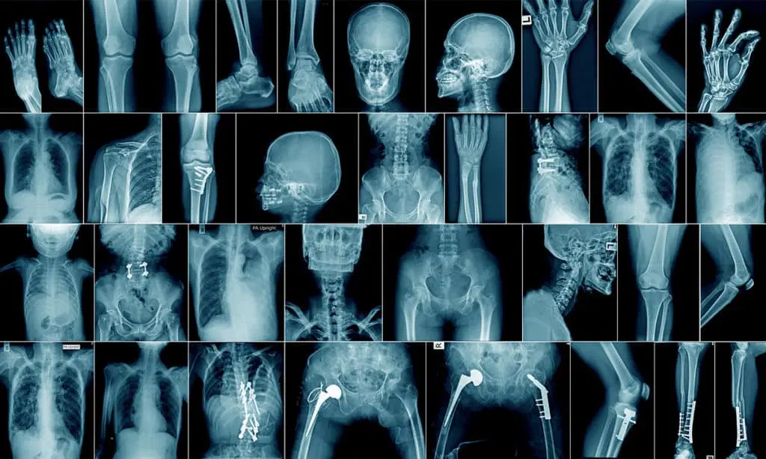
A Second Pair of Eyes: Diagnostics
Traditional Method
A traditional X-ray uses a beam of high-energy electromagnetic radiation to pass through the body, with a device like photographic film or a digital sensor on the other side capturing the X-rays that pass through.
AI-Assisted Method
AI algorithms can detect diseases like cancer, diabetic retinopathy, and neurological conditions from images, often with equal or greater accuracy than human experts.

Slide 5
Accelerating Cures & Personalizing Treatment
Drug Discovery: AI can analyze molecular structures to predict how they will interact with diseases, cutting years off the R&D timeline.
Personalized Medicine: By analyzing a patient's genetics and lifestyle, AI can help predict which treatments will be most effective.

Slide 6
The Diagnostic Dilemma: An Interactive Scenario
You are a consulting physician. A scan comes in with a suspicious nodule. What's your next step?

Slide 7
What Do You Do?
A) Rely solely on your initial diagnosis and proceed.
B) Use an AI diagnostic tool to analyze the scan for a second opinion.
C) Send the patient for immediate, invasive surgery.
Back to Scenario
Continue

Slide 8
A Valuable Learning Moment
While trusting your expertise (A) is crucial, and surgery (C) may be necessary, acting without all available data can carry risks.
Key Takeaway: The best modern practice combines human judgment with technological augmentation. AI provides a powerful, data-driven second opinion to reduce diagnostic errors.
Try Again!
Continue

Slide 9

Excellent Decision!
You've chosen to leverage technology to enhance your clinical judgment.
The AI tool confirms the nodule's high risk and flags two other subtle areas for review you hadn't initially noticed. This collaborative approach leads to a more confident diagnosis and a better-tailored treatment plan for the patient.
Continue

Slide 10
The Future is a Partnership
AI will not replace doctors, but doctors who use AI will replace those who don't.
Embracing AI means embracing better, faster, and more compassionate care for all.
Restart
Q&A

Slide 11
Q&A / Contact
Presented by: Yash Raj
Email: yashraj@gmail.com
Institution : National University of computer and emerging sciences.
Thank you for your attention!

